Slide 1
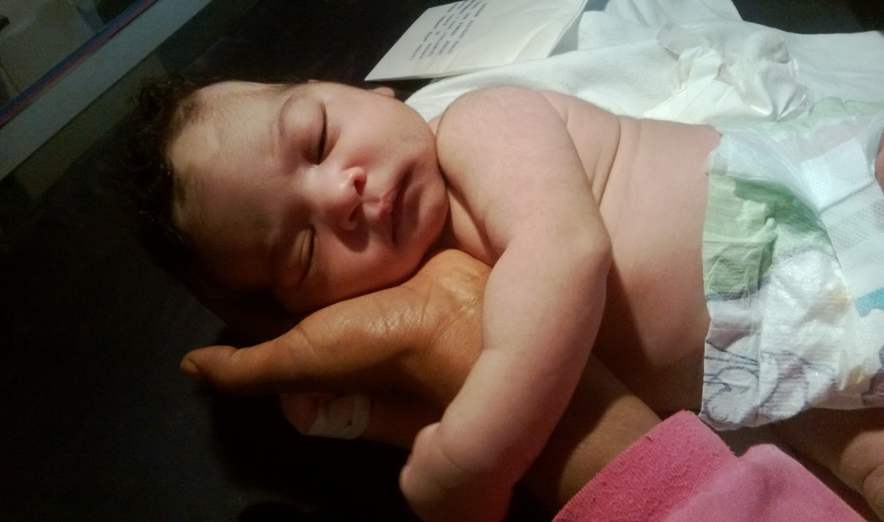
Common Neonatal Problems

Slide 2
Outline
PNA
Respiratory problems
Neonatal infections
Prematurity
Birth injuries

Slide 3
Perinatal Asphyxia
Lack of oxygen (Hypoxia)
Lack of perfusion (Ischemia)
26/1000 live births
20–30% of infants die in neonatal period
33–50% of survivors are left with permanent neurodevelopmental abnormalities

Slide 4
Diagnosis
PH <7.0
APGAR score of <5 at 5 and 10 minutes
Neurologic sequelae: ( seizures, hypotonia, coma
Multiorgan dysfunction

Slide 5
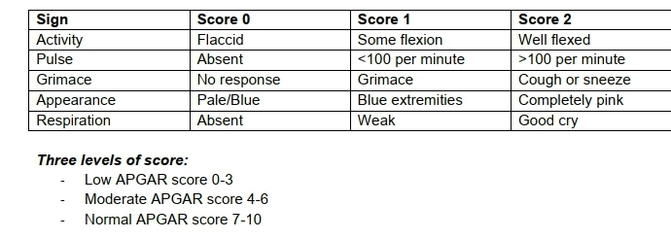
APGAR SCORE

Slide 6
PATHOPHYSIOLOGY
Anaerobic metabolism ogenerates lactate and inorganic phosphates
Brain edema, an increase of neurotransmitter release.
Excess activation of glutamate receptors, leads cell death
Nitric oxide and oxygen-free radicals production

Slide 7
PATHOPHYSIOLOGY
.
Acute asphyxia
Diving reflex
Shunting of blood to brain adrenals & heart
Away from lungs, kidney gut & skin
NONE BRAIN ORGAN DAMAGE
CEREBRAL CORTICAL LESIONS

Slide 8
Causes
Antepartum(20%)
Intra partum (70%)
Post partum(10%)

Slide 9
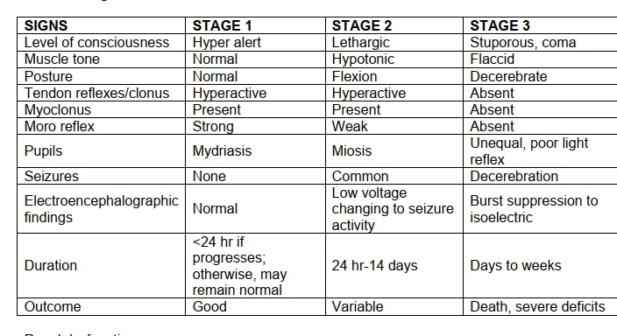
Staging

Slide 10
Causes of respiratory distresses
Meconium aspiration syndrome
RDS Hyaline Membrane Disease
Congenital pneumonia
Apnea

Slide 11
Hyaline Membrane Disease (HMD)
Resulting from lack of surfactant
Inversely proportional to gestational age & birth weight. Occurs in:
60 – 80% of infants < 28 wks
15 – 30% of infants b/n 32 & 36 wks
Rare after 37 weeks
C/S delivery, precipitated labor ,Asphyxia, cold stress

Slide 12
Pathphysiology
Surfactant substances are produced by alveolar type II cells
Mature level found after 35 wks of gestation
Normally reduce surface tension of alveoli
Deficiency leads to:
High alveolar surface tension
Tendency of affected lung to become atelectatic
Failure to develop a functional residual capacity (FRC) &
Intrapulmonary shunting, hypoxemia, and cyanosis

Slide 13
Clinical manifestations
In the 1st 3 hrs of life – tachypnea, grunting, nasal flaring, chest retractions, & cyanosis → decreased air entry
The natural course is progressive worsening over the 1st 48 – 72 hrs of life

Slide 14
Diagnosis
History
P/E – respiratory distress & cyanosis
Lab – arterial blood gas show variable degrees of hypoxemia & hypercapnia
CXR – shows diffuse atelectasis

Slide 15
Prevention and treatment
Prevention:
Administration of corticosteroids to the mother 24 – 48 hrs before delivery
Treatment : CPAP ,surfactant

Slide 16
Meconium Aspiration Syndrome (MAS)
Chemical pneumonitis and obstruction of the bronchi
Meconium aspiration is found in 5-15% of births, mostly in post terms
5% of such infants develop MAS
In 5-10% of them die

Slide 17
MAS…
Commonly occurs in the setting of fetal distress
hypoxia triggers vagal stimulation of intestine with passage of meconium to AF and
Fetal gasping leading to aspiration
Most severe in post terms

Slide 18
Clinical manifestation
Mild to severe RD
Air trapping by partial bronchial obstruction
Tension pneumothorax
Increased anterior-posterior chest diameter
Meconium staining of umbilical cord, nails

Slide 19
Tratment
As it occurs with the first breath the best therapy is PREVENTION
Oropharyngeal suctioning before delivery of chest
Endotracheal intubation and mechanical ventilation
Antibiotics

Slide 20
Hypothermia
All neonates are at risk of hypothermia
This is due to
Amniotic fluid ,cold & dry env’t
Larger surface area
Subcutaneous fat is thinner
low ability to conserve heat.

Slide 21
Body Temperature
37.5 C
36.5 C
36.0 C
32.0 C
Normal range
Mild hypothermia
Moderate hypothermia
Severe hypothermia
Cold injury

Slide 22
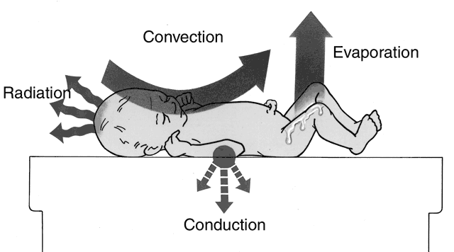
Mechanisms of heat lose

Slide 23
Clinical manifestation of Hypothermia
Peripheral vasoconstriction
- Acrocyanosis, decreased peripheral perfusion
CNS depression
- Lethargy, poor feeding, apnea and bradycardia
3. Increased metabolism
- Hypoglycemia, hypoxia, metabolic acidosis
4. Increased pulmonary arterial pressure
- Tachypnea, respiratory distress
5.Depressed Immunologic system
- develop septicemia, sclerema, DIC

Slide 24
Infection
Early Onset neonatal sepsis (<7 days)
Late Onset neonatal sepsis (> 7 days)
Bacterial meningitis
Congenital pneumonia
Neonatal Sepsis

Slide 25
Causative organisms
Group B streptococcus
Gram-negative enterics (esp. E. coli)
Listeria monocytogenes, Staphylococcus, other streptococci (entercocci), anaerobes, H. flu

Slide 26
Clinical presentation
Temperature irregularity
Change in behavior
Lethargy, irritability, changes in tone
Skin changes
Poor perfusion, mottling, cyanosis, pallor, petechiae, rashes, jaundice
Feeding problems
Intolerance, vomiting, diarrhea, abdominal distension
Cardiopulmonary
Tachypnea, grunting, flaring, retractions, apnea, tachycardia, hypotension
Metabolic
Hypo or hyperglycemia, metabolic acidosis

Slide 27
Neonatal jaundice
Is a yellowish discoloration of the skin and or sclera due to bilirubin deposition.
Almost 97 % healthy full term babies have biochemical hyperbilirubinemia.
It could be physiologic or pathologic

Slide 28
Causes of Jaundice
Isoimmunization
RH and ABO incompatibility,
Other blood group incompatibility
Infection
Sequestered blood
Subgalial hemorrhage, cephal hematoma
Erythrocyte biochemical defect
G6PD deficiency

Slide 29
Cont’d
Structural abnormalities of erythrocytes:
Hereditary spherocytosis, eliptocytosis
Disorder of hepatic uptake:
Gilbert syndrome
Disorder of conjugation:
Crigler – Najar syndrome (absence of UGT activity)
Disorder of enterohepatic circulation
Breast feeding Jaundice
Hypothyroidism:

Slide 30
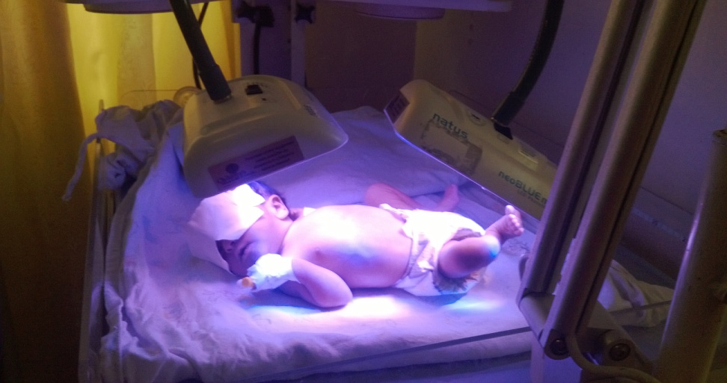
Principles of treatment
Phototherapy
Exchange transfusion
Note: Use Butanic curve for choosing the management options.

Slide 31
Assignment
Read on birth injuries and on prematurity

